Slide 1
Capstone Project: Segment
Lesson 20-1.2

Slide 2

The Big Picture
Final Project
Project Design
Train Model & Build Database
Dashboards Presentation
Python Unit
Python
Pandas
Matplotlib
APIs
Unit Assessment
Final Project
Project Design
Train Model & Build Database
Dashboards Presentation
Python Unit
Python
Pandas
Matplotlib
APIs
Unit Assessment
Visualization Unit
Web Scraping
Plotly
Leaflet
Tableau
Unit Assessment
Visualization Unit
Web Scraping
Plotly
Leaflet
Tableau
Unit Assessment
01
03
03
05
05
06
02
06
02
04
04
Excel Unit
Excel
VBA
Unit Assessment
Databases Unit
SQL
ETL
SQLite
Unit Assessment
Databases Unit
SQL
ETL
SQLite
Unit Assessment
Advanced Topics Unit
R—Stats
Big Data—AWS
Machine Learning
Unit Assessment
Advanced Topics Unit
R—Stats
Big Data—AWS
Machine Learning
Unit Assessment
Notes:
Data

Slide 3
Today is the beginning of the group project weeks.

Slide 4
We’ll begin working within our project groups this week. Take the time to connect with your group members early and often; communication is what will lead you all to success!

Slide 5




Project Segments
Your project work will be broken down into four segments. This week: “Sketch It Out”
Sketch It Out Decide on your overall project, select your question, and build a simple model. You'll connect the model to a fabricated database, using comma-separated values (CSV) or JavaScript Object Notation (JSON) files, to prototype your idea. | Build the Pieces Train your model, and build out the database you'll use for your final presentation. | Plug It In Connect your final database to your model, continue to train your model, and create your dashboard and presentation. | Put It All Together Put the final touches on your model, database, and dashboard. Lastly, create and deliver your final presentation to your class.

Slide 6
This Week: Capstone Project
By the end of this week, you will:
Decide on a topic for your project
Find preliminary datasets for your project
Perform rudimentary EDA on the datasets that have been found
Create a mockup of the database
Create a mockup of the machine learning model you are going to use

Slide 7
Today’s Agenda
Module 20

Slide 8

Today’s Agenda
By completing today’s activities, you’ll learn the following skills:
01
Creating a GitHub repository for the project with feature branches
02
Adding a README.md file to the repository to describe the project
03
Working in a group environment
Make sure you’ve downloaded any relevant class files!

Slide 9
Are you having any issues getting started?

Slide 10

GitHub Practice
Notes:
2. Intro & GitHub Practice

Slide 11
What Is Git?

Slide 12
Git is a tool for saving our work as we develop a project.
Git keeps track of our work over time.

Slide 13
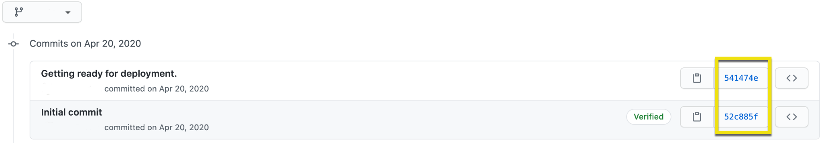
Git Commits
If we make a change that breaks something else in the project during the development phase, Git allows us to restore the working code from a previous commit.
Everytime you save using Git, Git remembers these “checkpoints” as a commit hash, which is a unique identifier.

Slide 14
If we made a commit that "broke" something in another part of the code, then we can use this unique identifier to revert the code to a previous commit.

Slide 15
Git Commits
The following Git command reverts the repository to the initial commit shown in the image below.
git reset 52c885f

Slide 16




Git Branching
A branch is essentially a history of updates or changes.
Main
Staging area is where you edit the files that will be part of the next commit.
Git repository
Staging area
Clone repo
branch
Create a new branch on your local repository.
Main
New
New Feature

Slide 17
As other team members make changes to the main code, their versions live on different branches.

Slide 18
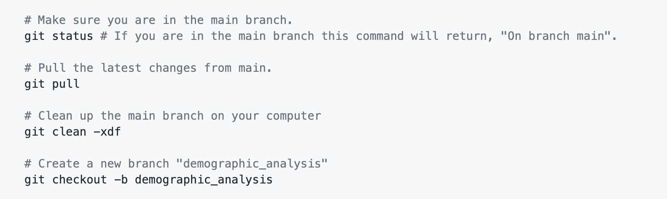
Git Branching
You are working on a project where you need to update the main code in order to analyze demographic data for Uber riders. The code you work on will be added in a branch called demographic_analysis.

Slide 19
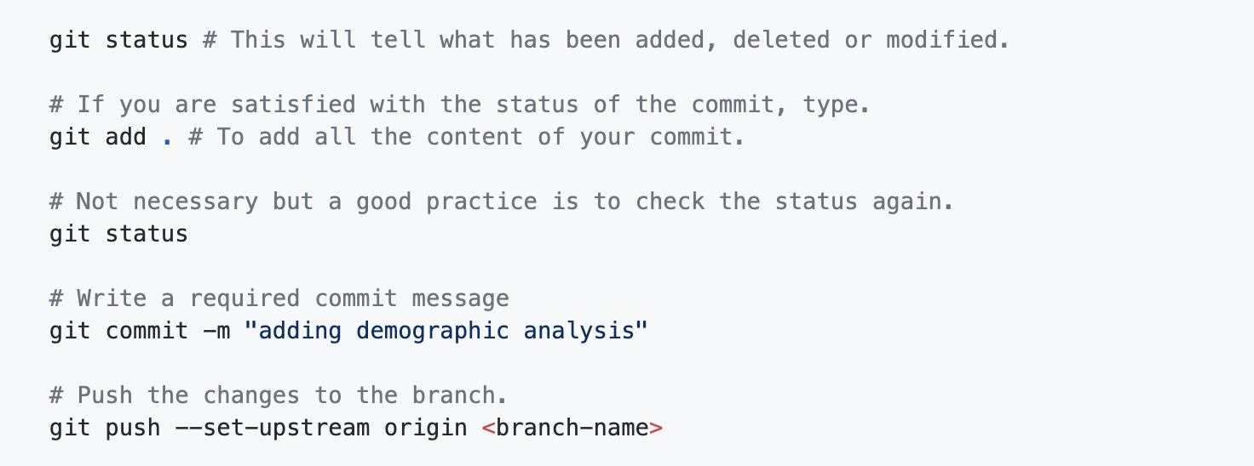
Git Branching
Next, you add the updated file from your computer to the repository and execute the following commands:

Slide 20
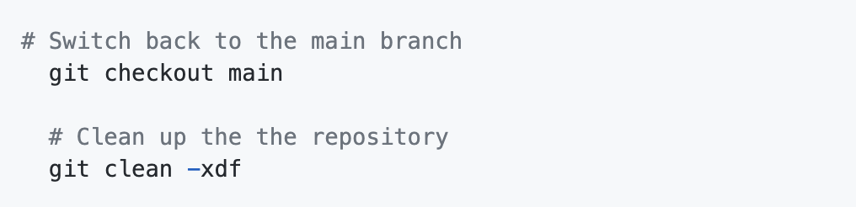
Git Branching
It is a good practice to navigate back to the main branch to perform a cleanup of repository files that are unneeded but not tracked by .gitignore.

Slide 21
Git Branching
We have a version of the code called main, which is the "main" version of our code, and a version called demographic_analysis, which contains updates.
Main
Main
Git repository
Clone repo
branch
In this case, the demographic_analysis branch diverged from the main branch.
Main
demographic_analysis
Demographic Analysis

Slide 22

Git Branching
The benefits of having a separate branch for analyzing Uber rider data:
01
02
It gives our collaborators a chance to review the branch for errors and offer suggestions.
After the proposed changes have been reviewed, we can update the main branch to include the changes from the demographic_analysis branch by initiating a merge.

Slide 23
Git Merging
After the changes have been reviewed, we can merge the demographic_analysis branch into the main branch.
Main
Main
Git repository
Clone repo
merge
branch
Main
demographic_analysis
Merge your branch into the main repository.
Demographic Analysis

Slide 24

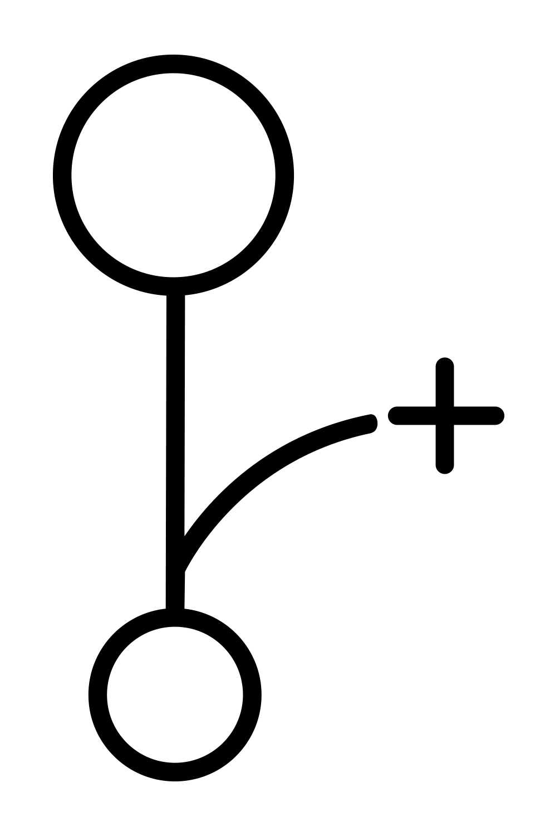


Git Merging
Merging two branches adds the content from the changed branch |to the branch it is based on.
1
2
3
4
Create a Branch:
Push up the add-style-css branch to your remote GitHub repo. It should have created a remote branch with the same name.
Open a Pull Request:
A pull request is essentially a request to merge code from one branch into another branch on GitHub.
Discuss and Review:
This helps catch any mistakes you might have made and helps teammates understand the work you’ve done.
Merge and Deploy:
Merge changes into the main branch and deploy the code.

Slide 25
Group GitHub Activities
Notes:
3. Group GitHub Activities

Slide 26
Create a Project Repository
10 minutes
Notes:
3.1 Everyone Do: Create a Project Repository (0:10)

Slide 27
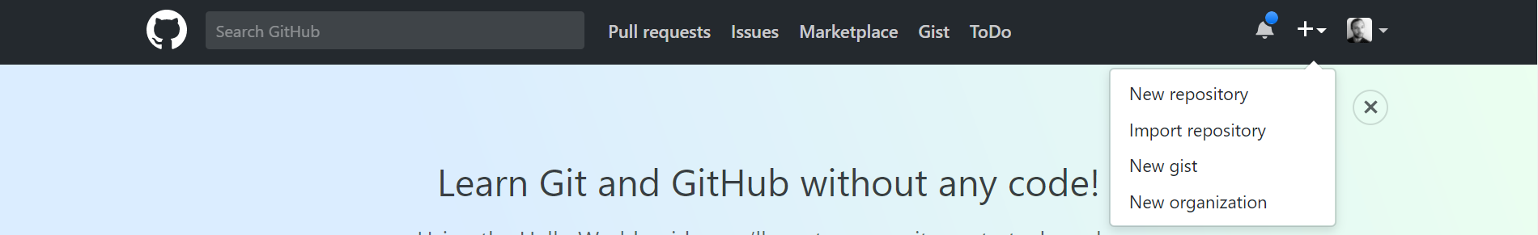
Create a Project Repository
Go to GitHub, then click the + in the top-right corner to create a new repository.

Slide 28
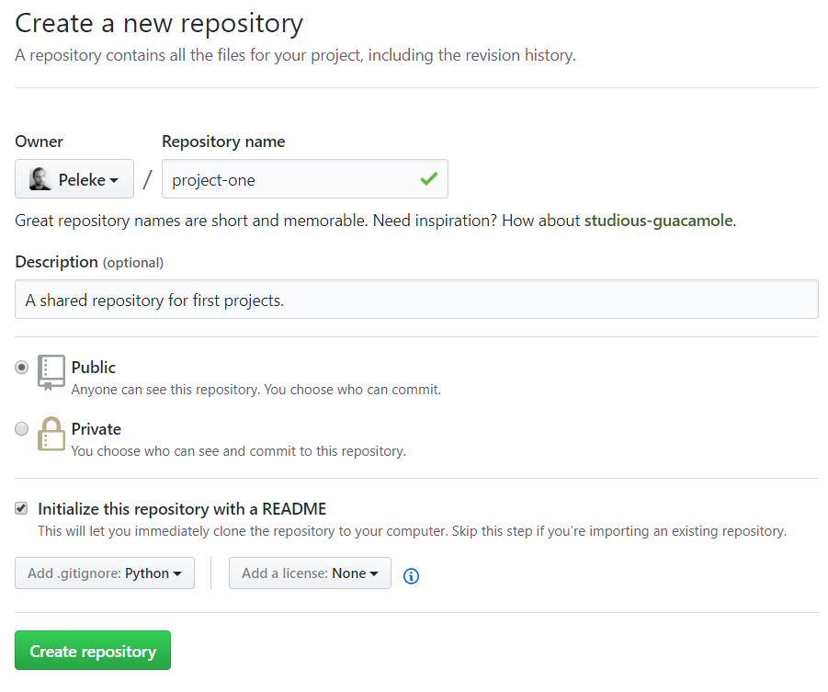
Create a Project Repository
Fill out the fields on the new repository page.
Initialize with a .gitignore.
Students should choose Python in the .gitignore dropdown.

Slide 29
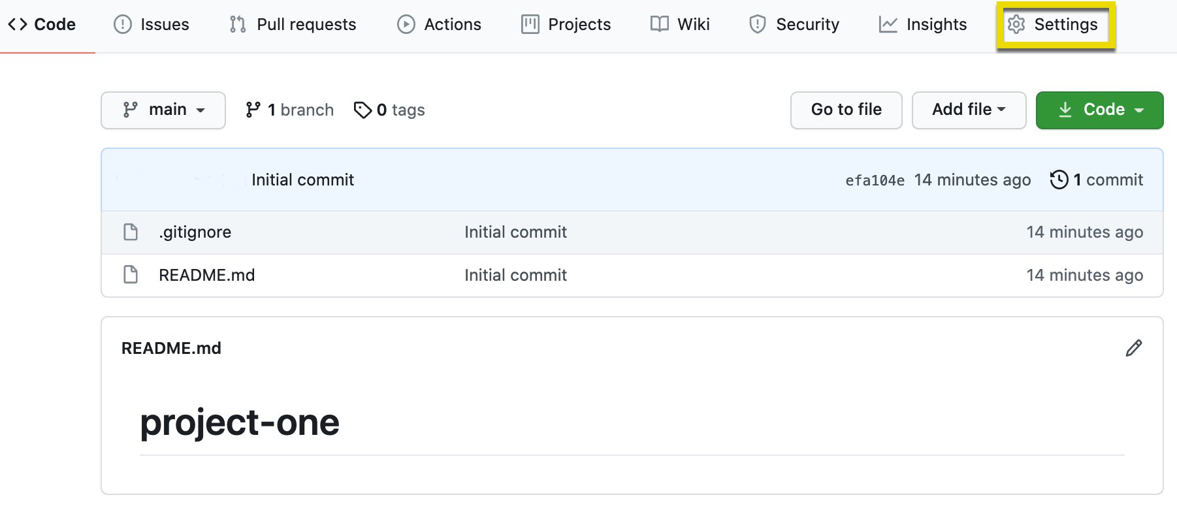
Adding Collaborators
Navigate to the repository settings.

Slide 30
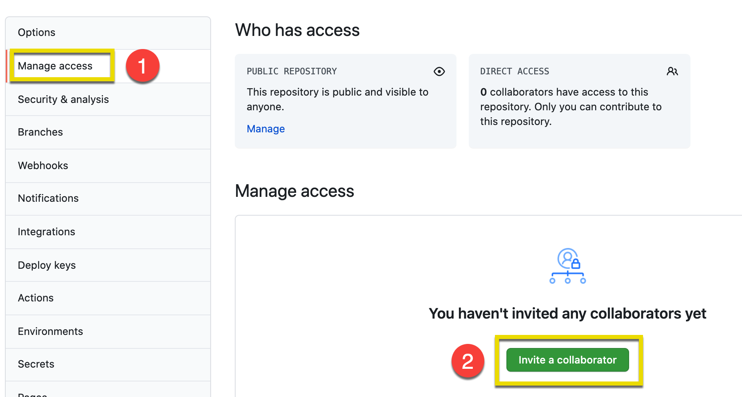
Adding Collaborators
On the "Settings" page, click "Manage access" on the left, enter your GitHub password when prompted, then click "Invite a collaborator."

Slide 31
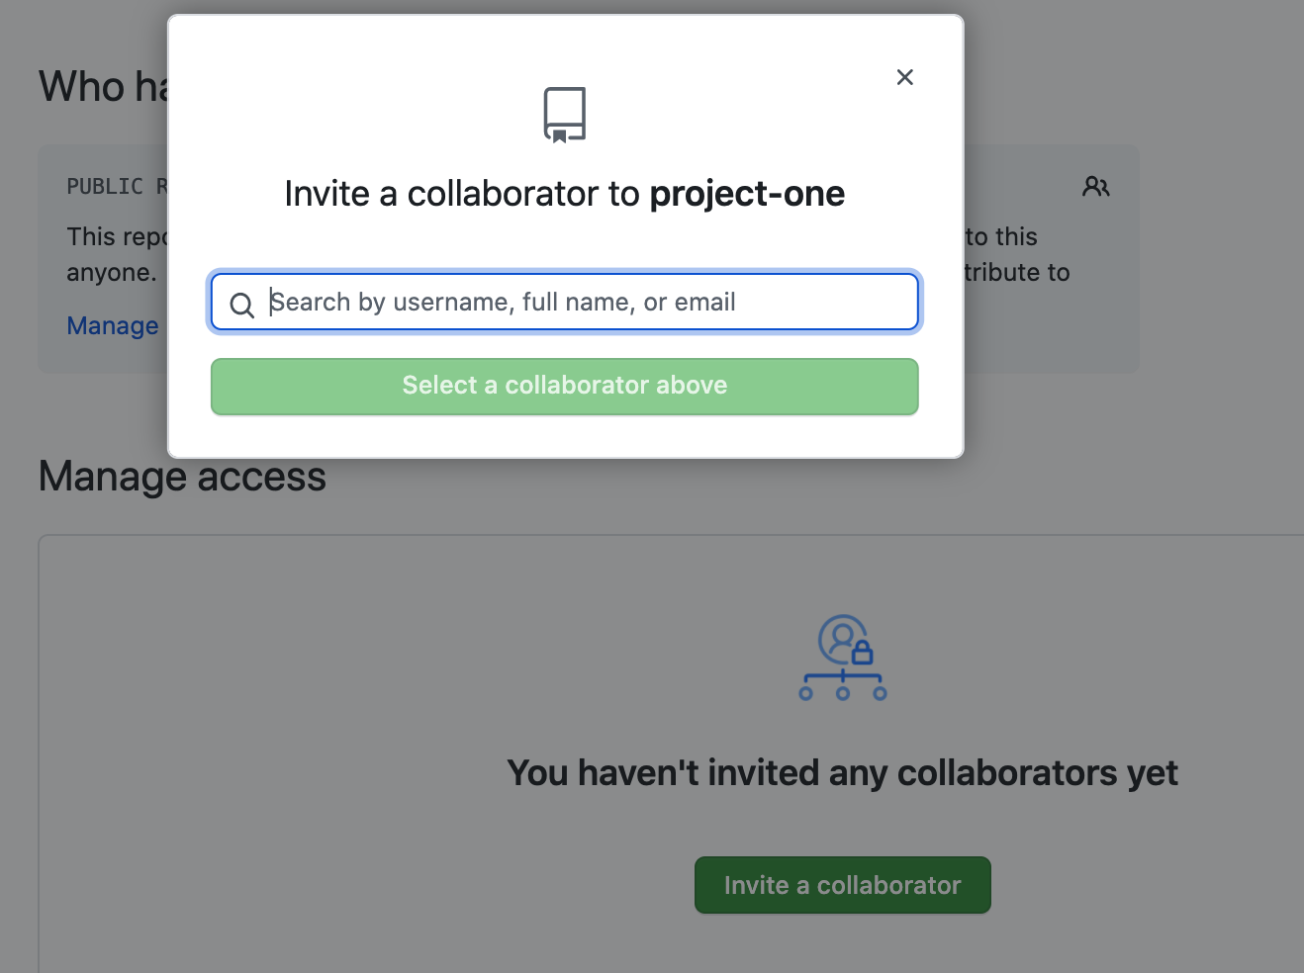
Adding Collaborators
A popup window will appear for the owner of the repository to search for their teammates by GitHub username.

Slide 33
Creating Branches
10 minutes
Notes:
3.2 Everyone Do: Creating Branches (0:10)

Slide 34
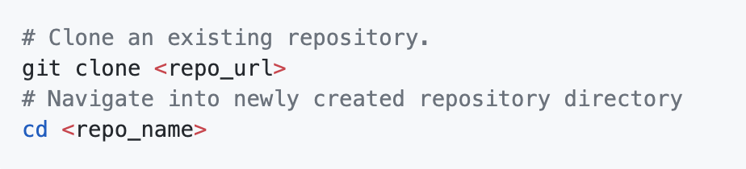
Clone from GitHub
If someone has already shared a repository on GitHub, you can clone it to your local machine with git.

Slide 35
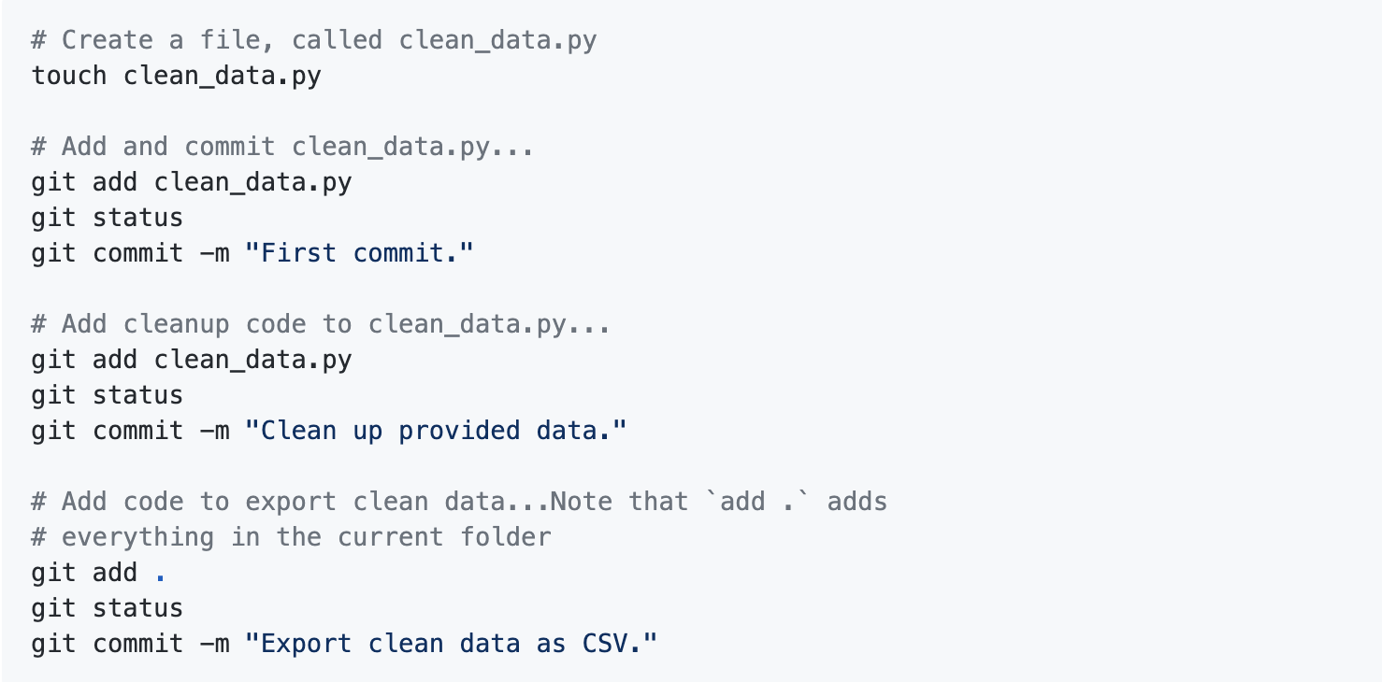
Adding Files
In the examples below, we use git status before every git commit. This is a best practice that helps ensure a deliberate commit history.

Slide 36
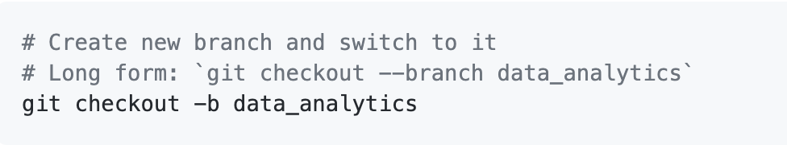
Create Branches
To create a new, isolated development history, we must create branches.

Slide 37
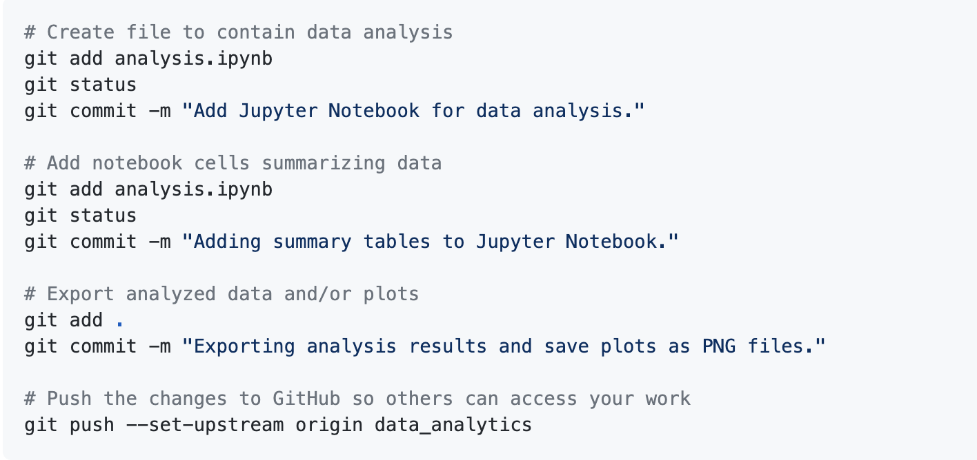
Create Branches
Once we've created a new branch, we can develop as normal and then add those changes to the branch.

Slide 39
Creating a Pull Request, Reviewing Code, and Merging
10 minutes
Notes:
3.3 Everyone Do: Creating a Pull Request, Reviewing Code, and Merging (0:10)

Slide 40
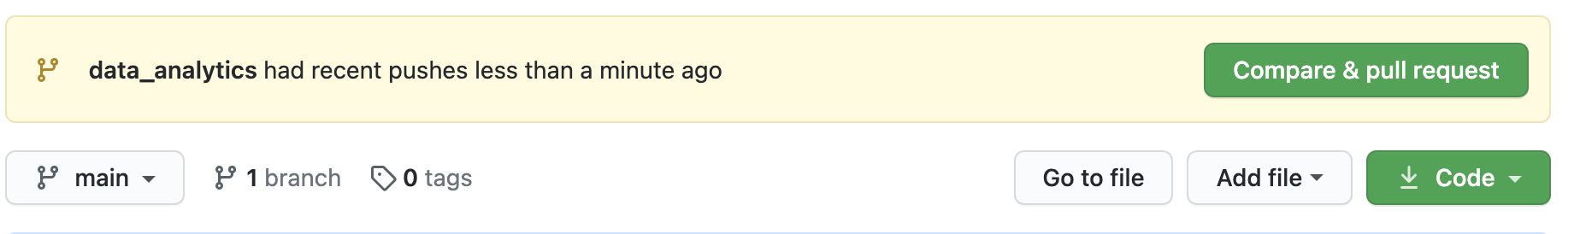
Creating a Pull Request, Reviewing Code, and Merging
Once you have pushed the changes to your branch, GitHub will create a message for you to compare the changes you made against the main branch.

Slide 41
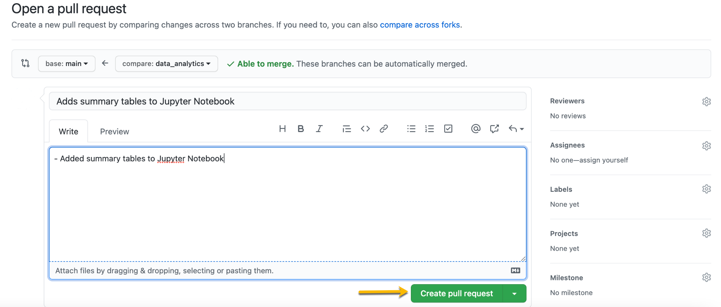
Creating a Pull Request, Reviewing Code, and Merging
After you click "Compare & pull request," GitHub will create a "pull request," or a PR, where you can add a description of the changes you made to the "main" code.

Slide 42
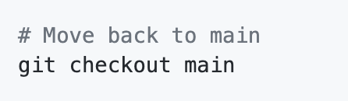
Creating a Pull Request, Reviewing Code, and Merging
Use the checkout command on the main branch, then navigate to the repository on your computer.

Slide 43
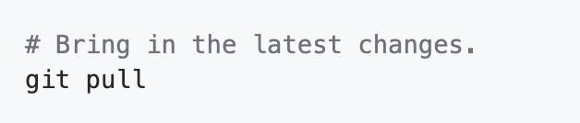
Creating a Pull Request, Reviewing Code, and Merging
Type and run git pull. This will bring the changes into the main branch.

Slide 44
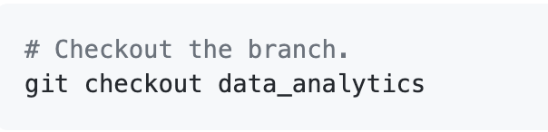
Creating a Pull Request, Reviewing Code, and Merging
Then, run git checkout <branch_name>, where <branch_name> is the name of one of your teammates' branches.

Slide 45
At this point, your teammates can review and test the code. After testing the code, a teammate can approve the changes or request that changes be made.

Slide 46
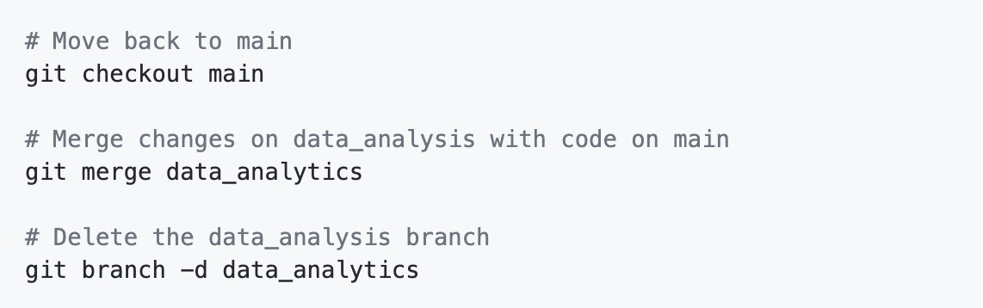
Creating a Pull Request, Reviewing Code, and Merging
Once the code has been approved, the data_analytics branch can be merged into the main branch.

Slide 47
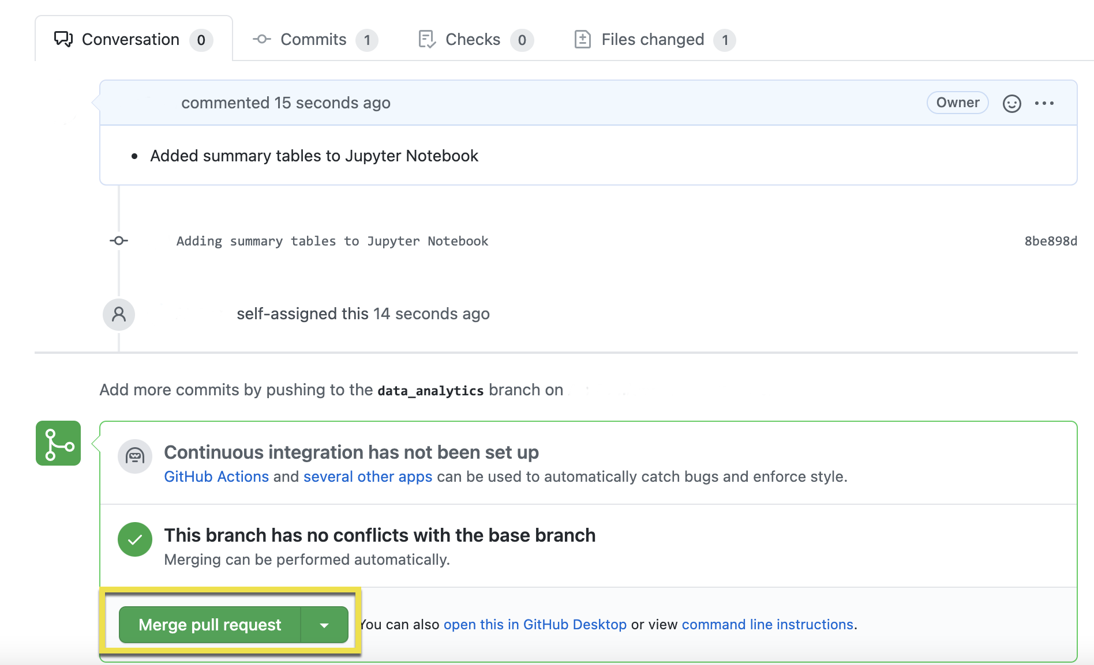
Creating a Pull Request, Reviewing Code, and Merging
Alternatively, you can merge the branch on GitHub.

Slide 48
Deleting the data_analytics branch isn't necessary, but it is best practice to prune unneeded branches.

Slide 49

Working in Teams
Notes:
3.4 Instructor Do: Working in Teams (0:10)

Slide 50
Working in Teams
Each team member should have one of the following roles:
Square | The team member in the square role will be responsible for the repository.
Triangle | The member in the triangle role will create a mockup of a machine learning model. This can even be a diagram that explains how it will work concurrently with the rest of the project steps.
Circle | The member in the circle role will create a mockup of a database with a set of sample data, or even fabricated data. This will ensure that the database works seamlessly with the rest of the project.
X | The member in the X role will decide which technologies to use for each step of the project. If the team has only three members, then all three members should be contributing to these decisions.

Slide 51
Project Development Consultation

Slide 52
Project Progression—Next Steps
Notes:
4.1 Instructor Do: Project Progression—Next Steps (0:05)

Slide 53
Project Progression—Next Steps
For the next class, you should have completed the following:
Create a mockup of a machine learning model.
Create a mockup or fabricate a database.
Create an outline for the final dashboard with a storyboard of visualizations.
Continue using GitHub to create and merge code on branches.

